Slide 1
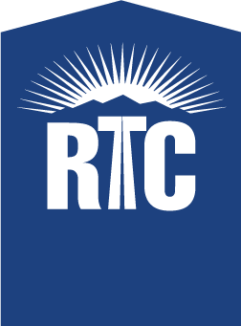
Future Projects in Southern Nevada
Notes:
Good morning, and thank you for having me here today. I’m excited to tell you about some of the RTC’s recent projects and initiatives. But before I provide you with this update, I would like to give you a quick reminder of who we are…

Slide 2
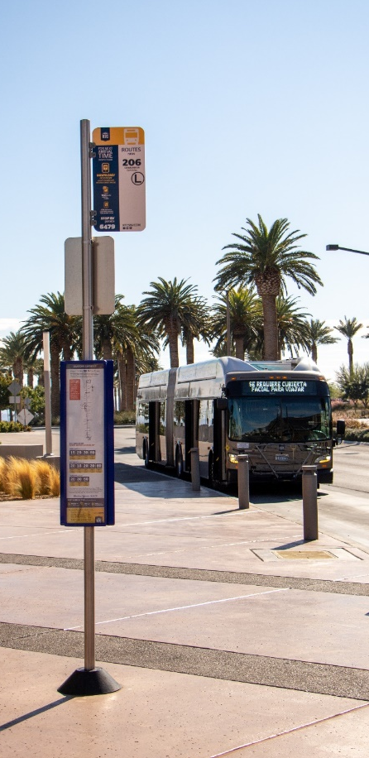
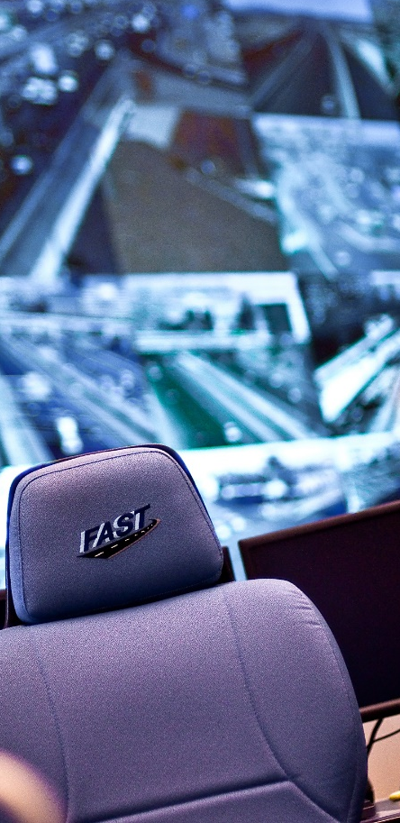
Who We Are
Transit
Planning
Roadway Funding
Traffic Management
Bicycling
Notes:
At the RTC, our fundamental role is to connect people. You may know us for transit, roadways, or cycling, but we touch every cornerstone of this community: from the bus you take and the road your drive on, to the traffic light that maintains order, and the bike lanes and sidewalks that provide safe travel options.
So what does that look like?
The RTC is the regional planning agency, otherwise known as the Metropolitan Planning Organization (MPO), and we work with all the local jurisdictions to fund and plan roadways.
We are the transit provider for the region. And we are responsible for traffic management, coordinating traffic signals, dynamic message signs and ramp meters.
Finally, we oversee the bike share system in downtown Las Vegas, among other cycling initiatives.
We are unique with all of these operations under one roof, and that enables us to be more efficient and effective as the transportation agency for Southern Nevada.

Slide 3
Regional Transportation Plan Update

Slide 4
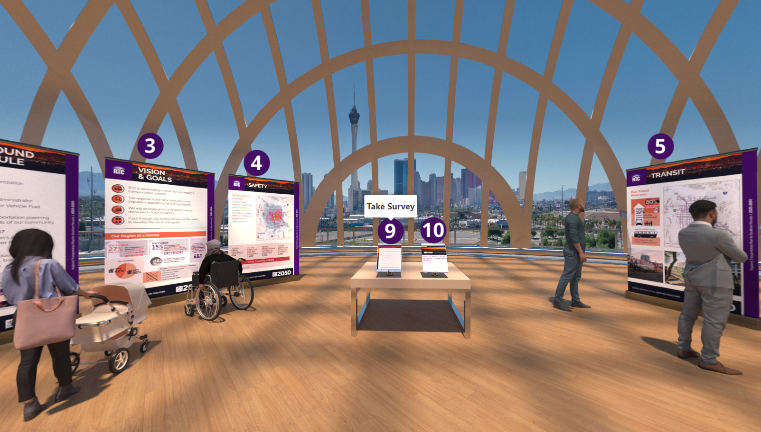
Public Engagement
First Public Comment Period Complete | February 15-March 31, 2024
Notes:
Survey closed on 3/31 – RTC used a combination of digital and in-person engagement to invite residents to visit the virtual public meeting take the brief survey

Slide 5
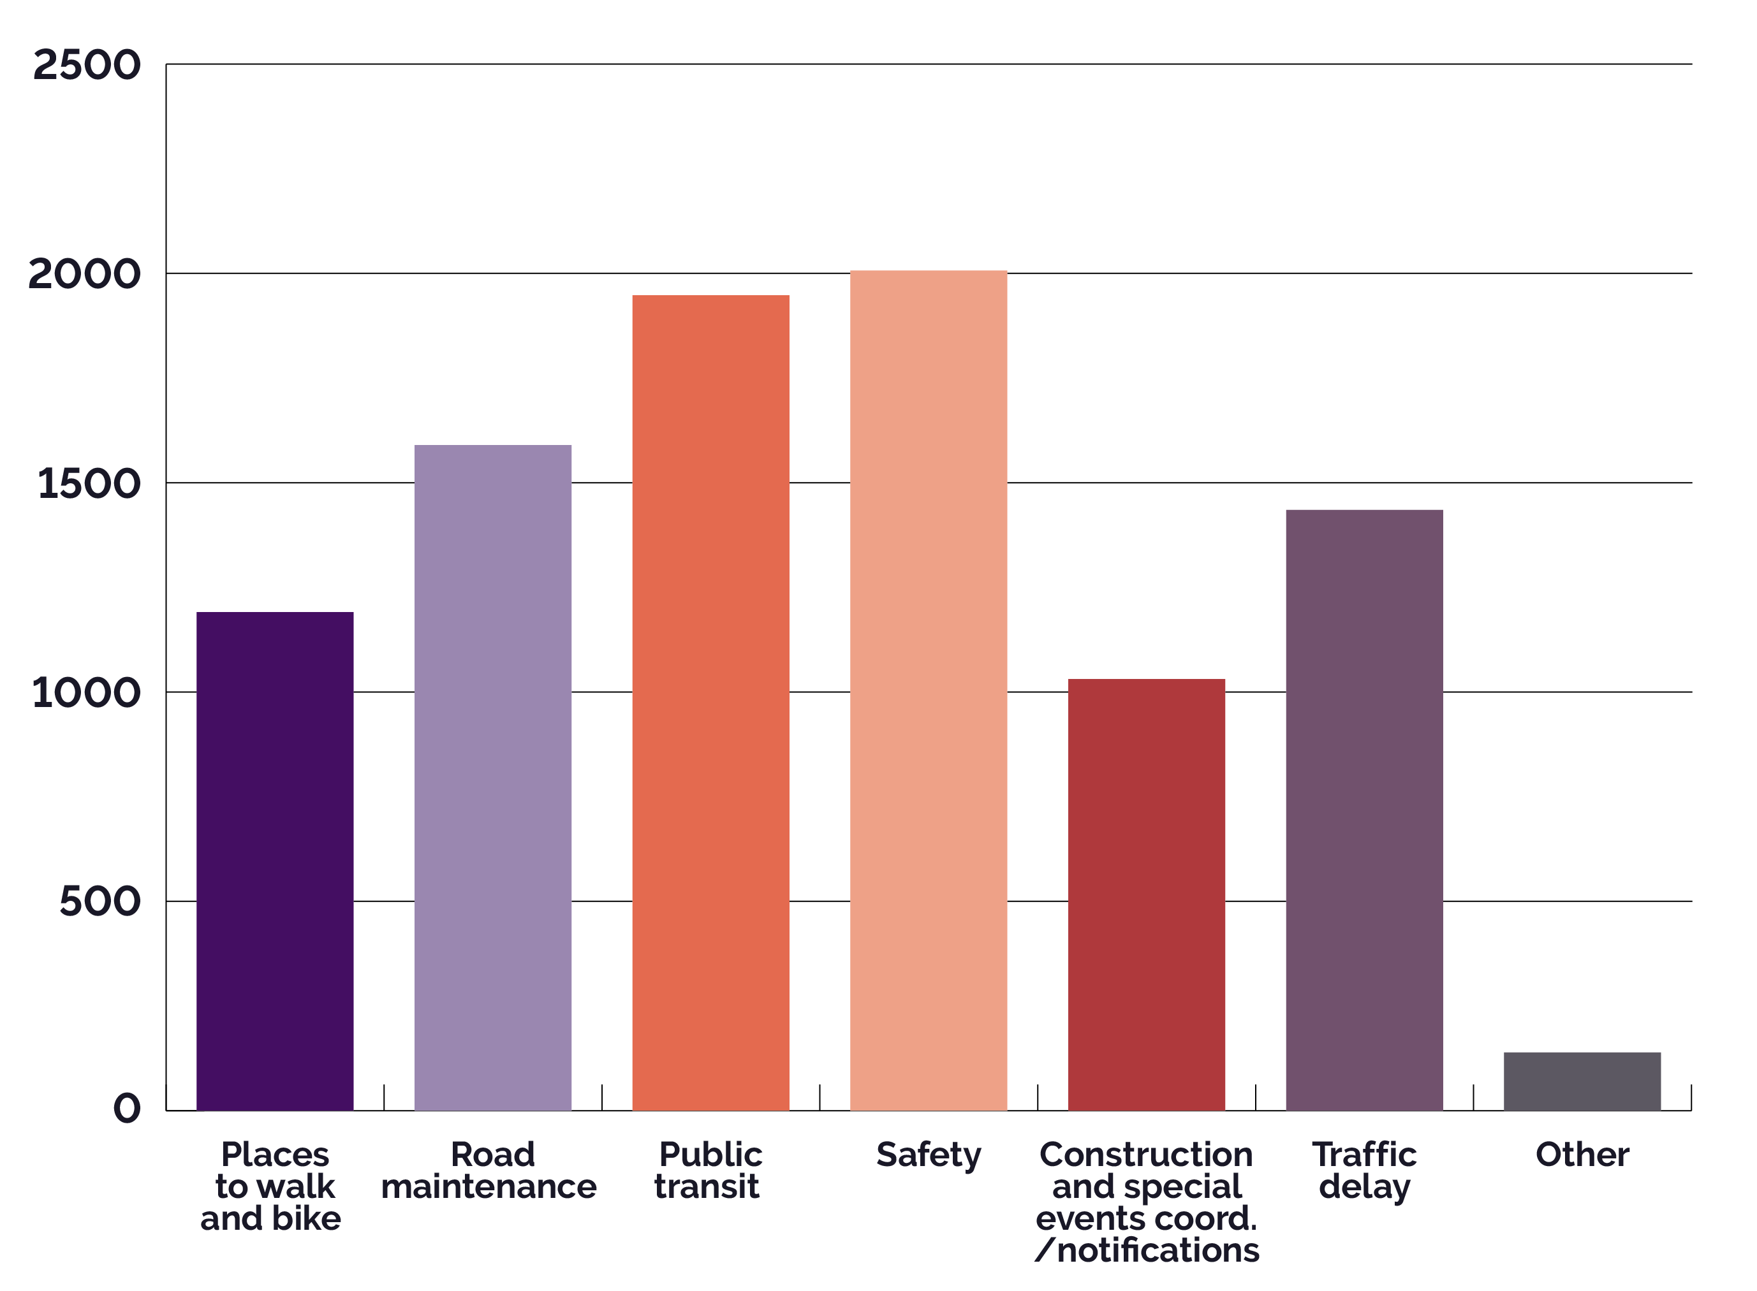
Public Engagement
What transportation issue is most important to you?
(Participants could select up to 3)
Over 4,100 surveys received and 25+ community events attended
Notes:
Survey closed on 3/31 – results are being analyzed (Safety and transit are the top two priorities for survey participants)
Highlight the Project Benefits Calculator – that CFP submittals are in that process at this time.

Slide 6
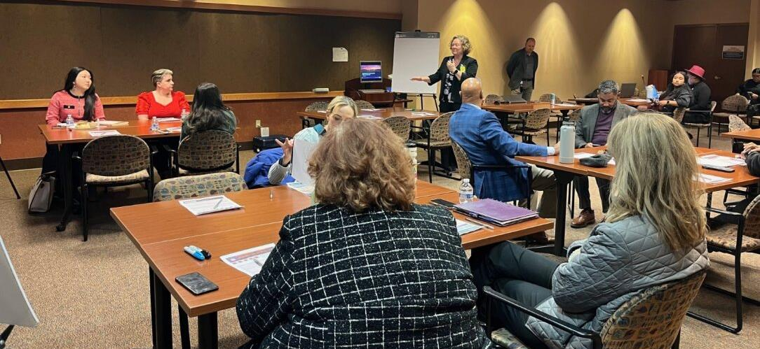
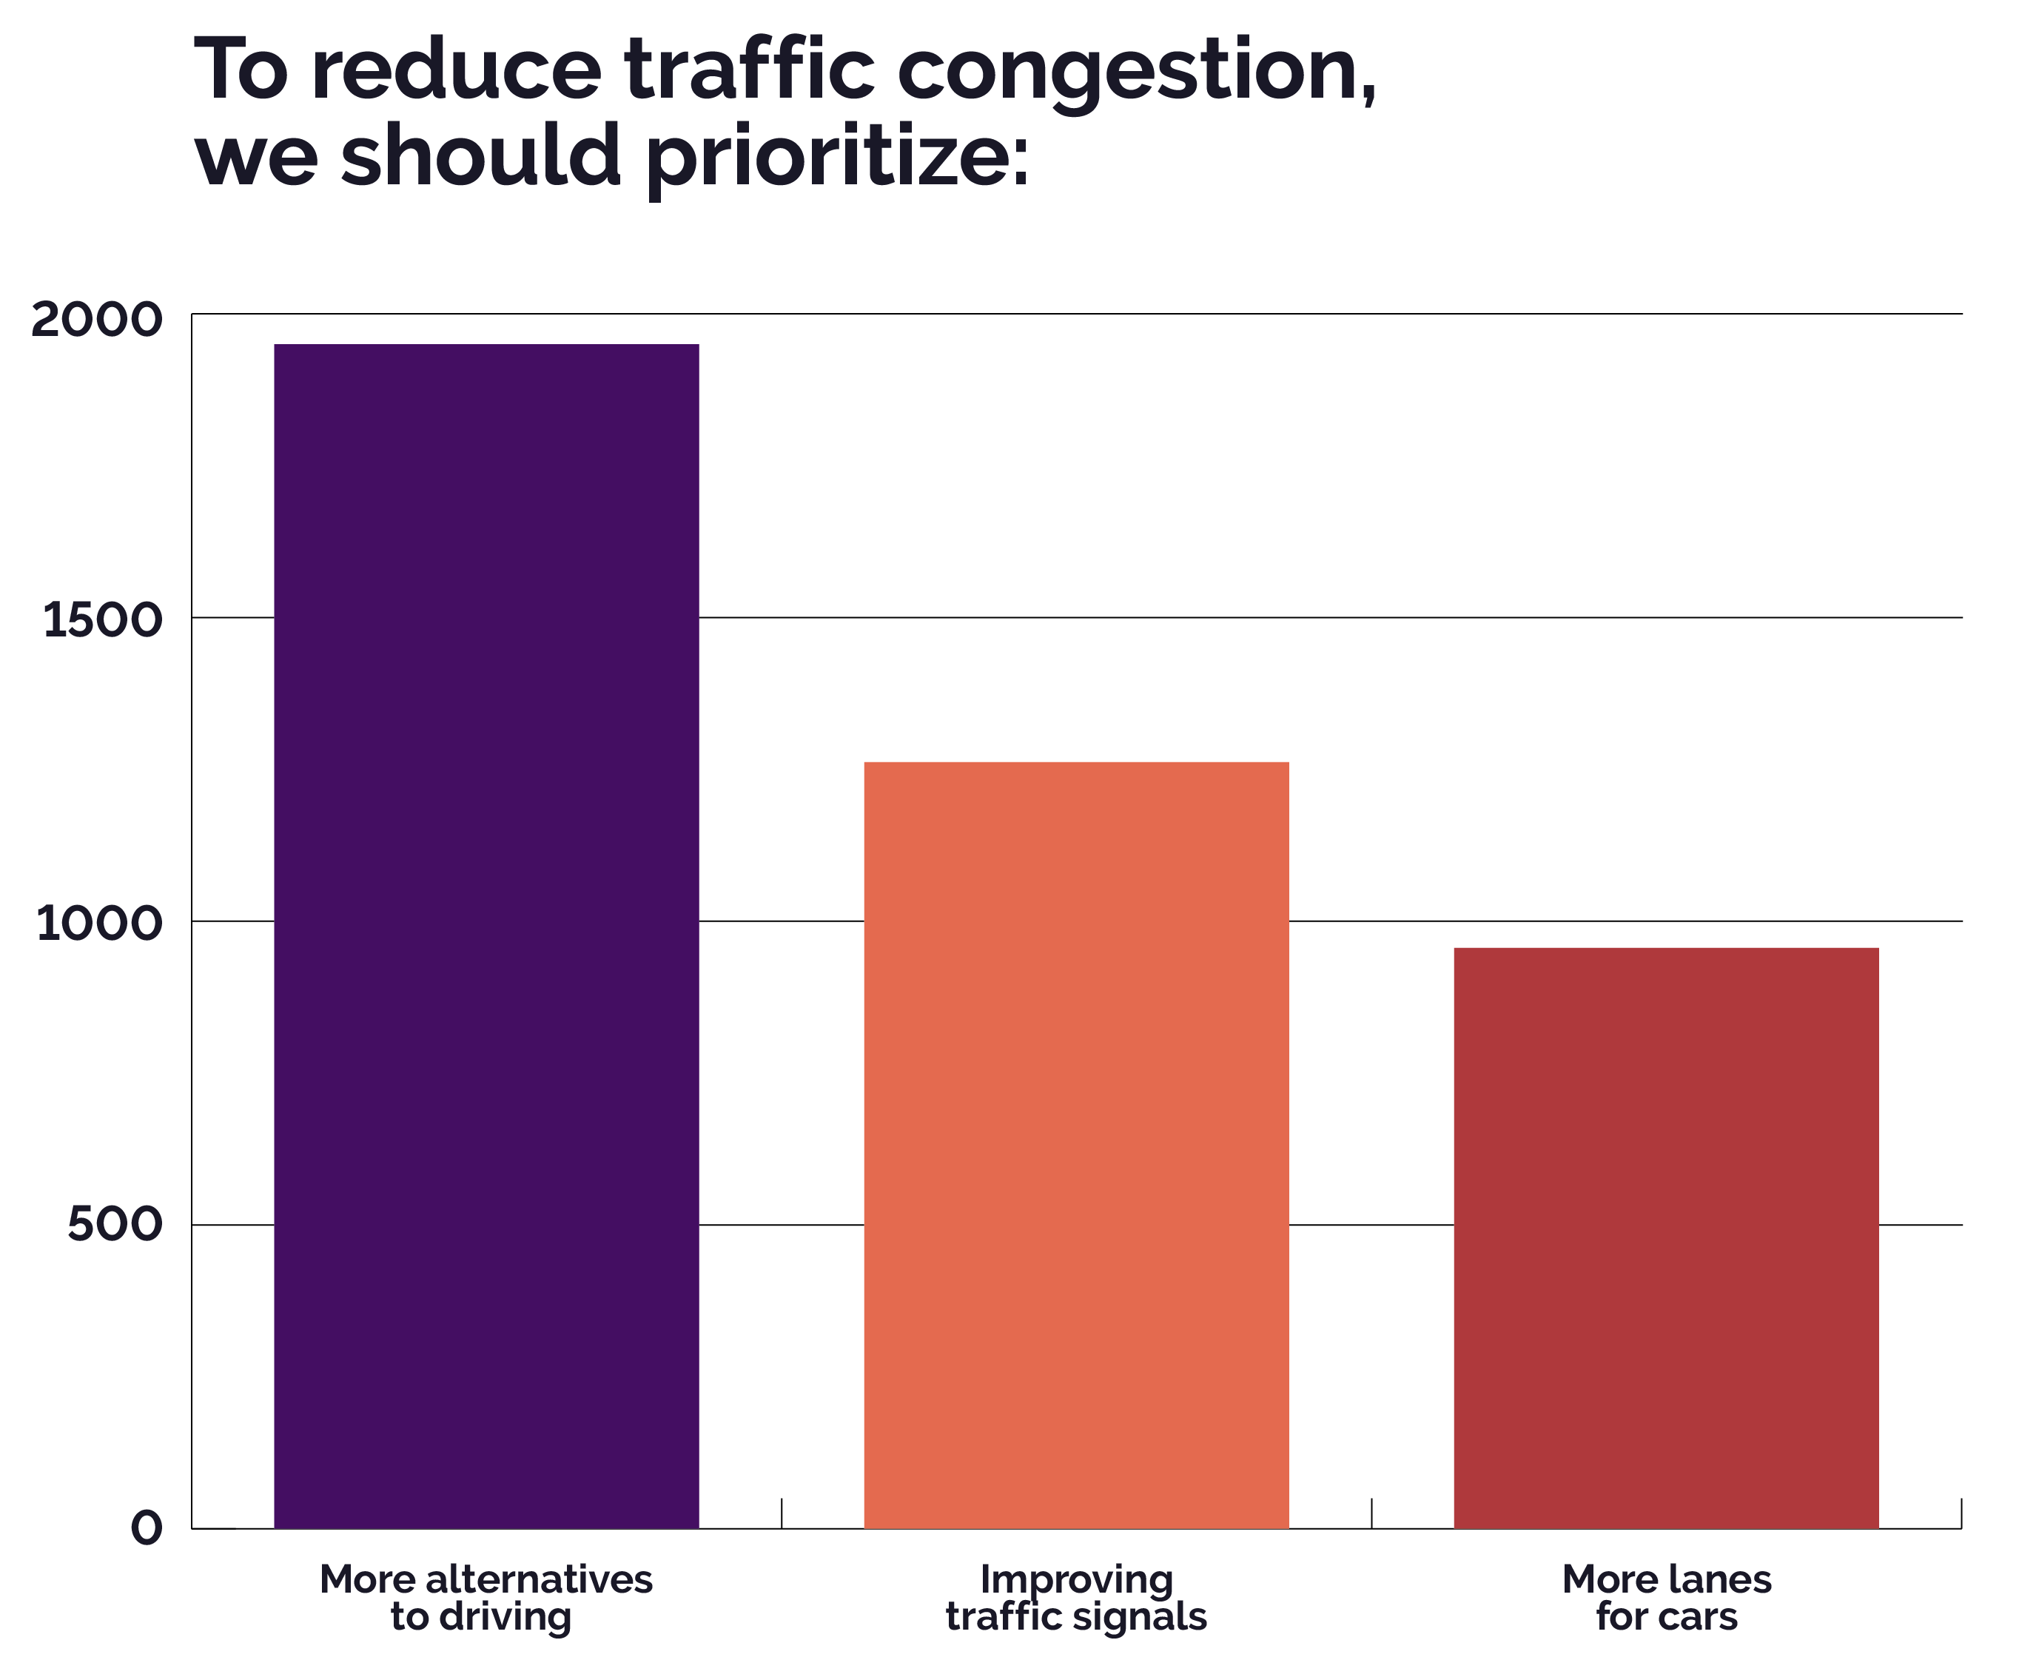
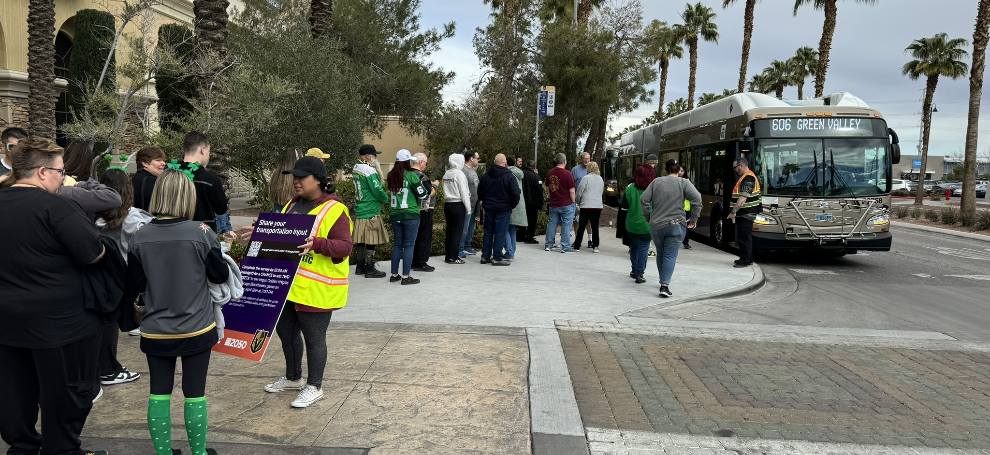
Priorities
Notes:
Notation that values and goals came out of community and stakeholder input.
Workshops held, virtual and in person. Well attended and valuable input received.

Slide 7
Call for Projects – February 2024
Types of Projects
Regionally Significant
Federal Funding Secured
Requesting Federal Funding
RTP call for projects is a mechanism to access federal funds
Total Project Requests
120
Local Projects from Public Works
91
RTC Projects
17
NDOT Projects
12
Notes:
Highlight the Project Benefits Calculator – that CFP submittals are in that process at this time.
RTP includes projects of regional significance, regardless of funding source.
Projects receiving federal funds must be included in the RTP, regardless of the amount of federal funds.

Slide 8
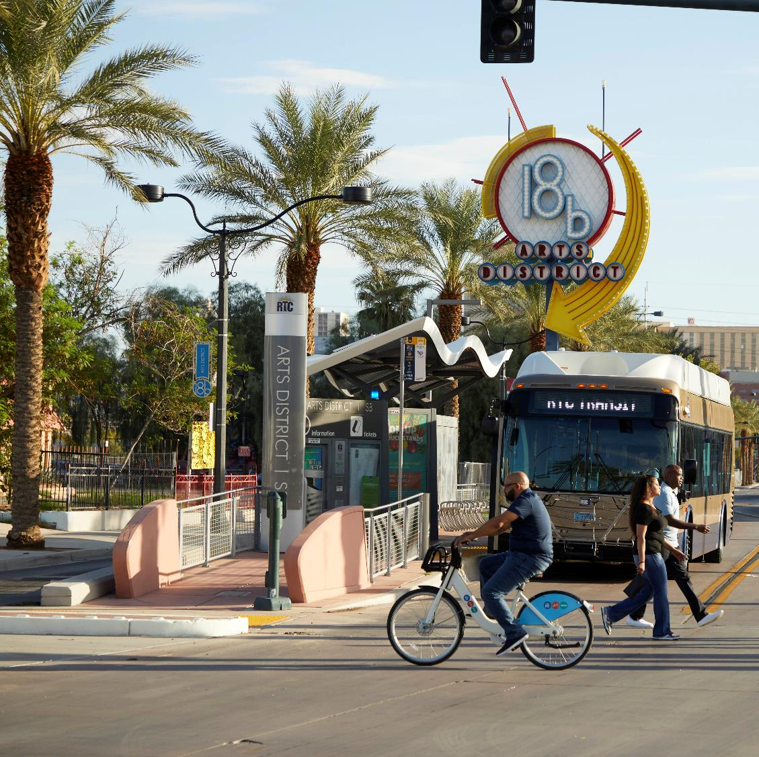
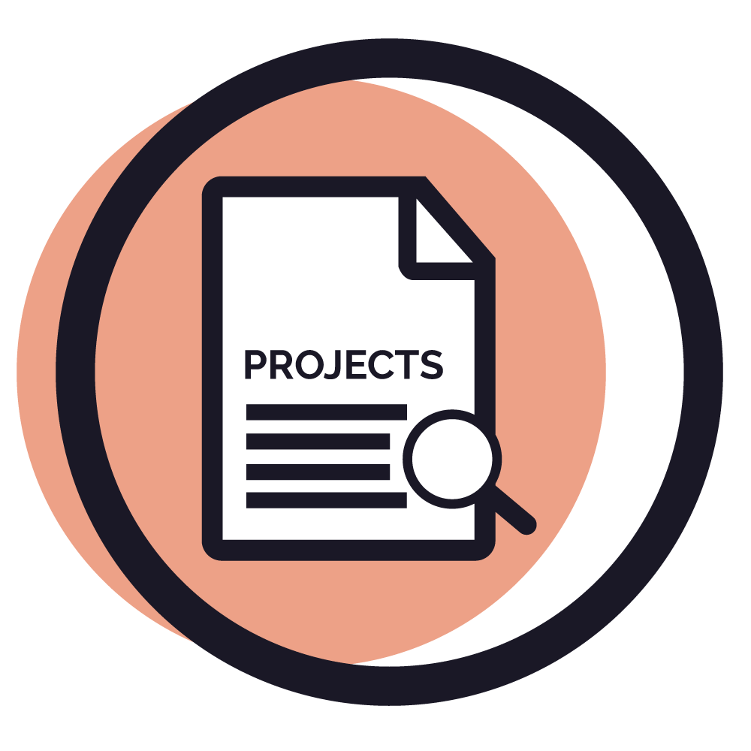
Next Steps
Review and prioritize projects, per FHWA requirements
Continue collaboration with partner agencies and the public
Develop draft plan
Notes:
Technical work and initial plan development are in progress.
Will be back in for another round of public input in late Summer early Fall.

Slide 9
Regional Planning Key Functions
Implement New Federal Policy
Provide Technical Assistance
Lead Regional Planning
Housing
Extreme Heat
Open Space and Trails
Economic Development
Transportation Electrification
Population Projections
Federal Lands Access
Regional Plan Administration
Livable Centers
Climate Change
Grants Coordination
Notes:
Regional Planning work typically falls into 3 areas:
First, we are focused on meeting new federal requirements.
Second, we provide technical assistance to address regional-scale planning challenges or gaps. Examples include extreme heat, housing, and transportation grants coordination.
Lastly, we provide leadership in a few areas previously led by the Southern Nevada Regional Planning Coalition (SNRPC):
This includes facilitation of the Regional Open Space and Trails Workgroup.
We also work with SNWA to develop annual population projections.
At the heart of our work, is administering the Southern Nevada Strong regional plan.

Slide 10
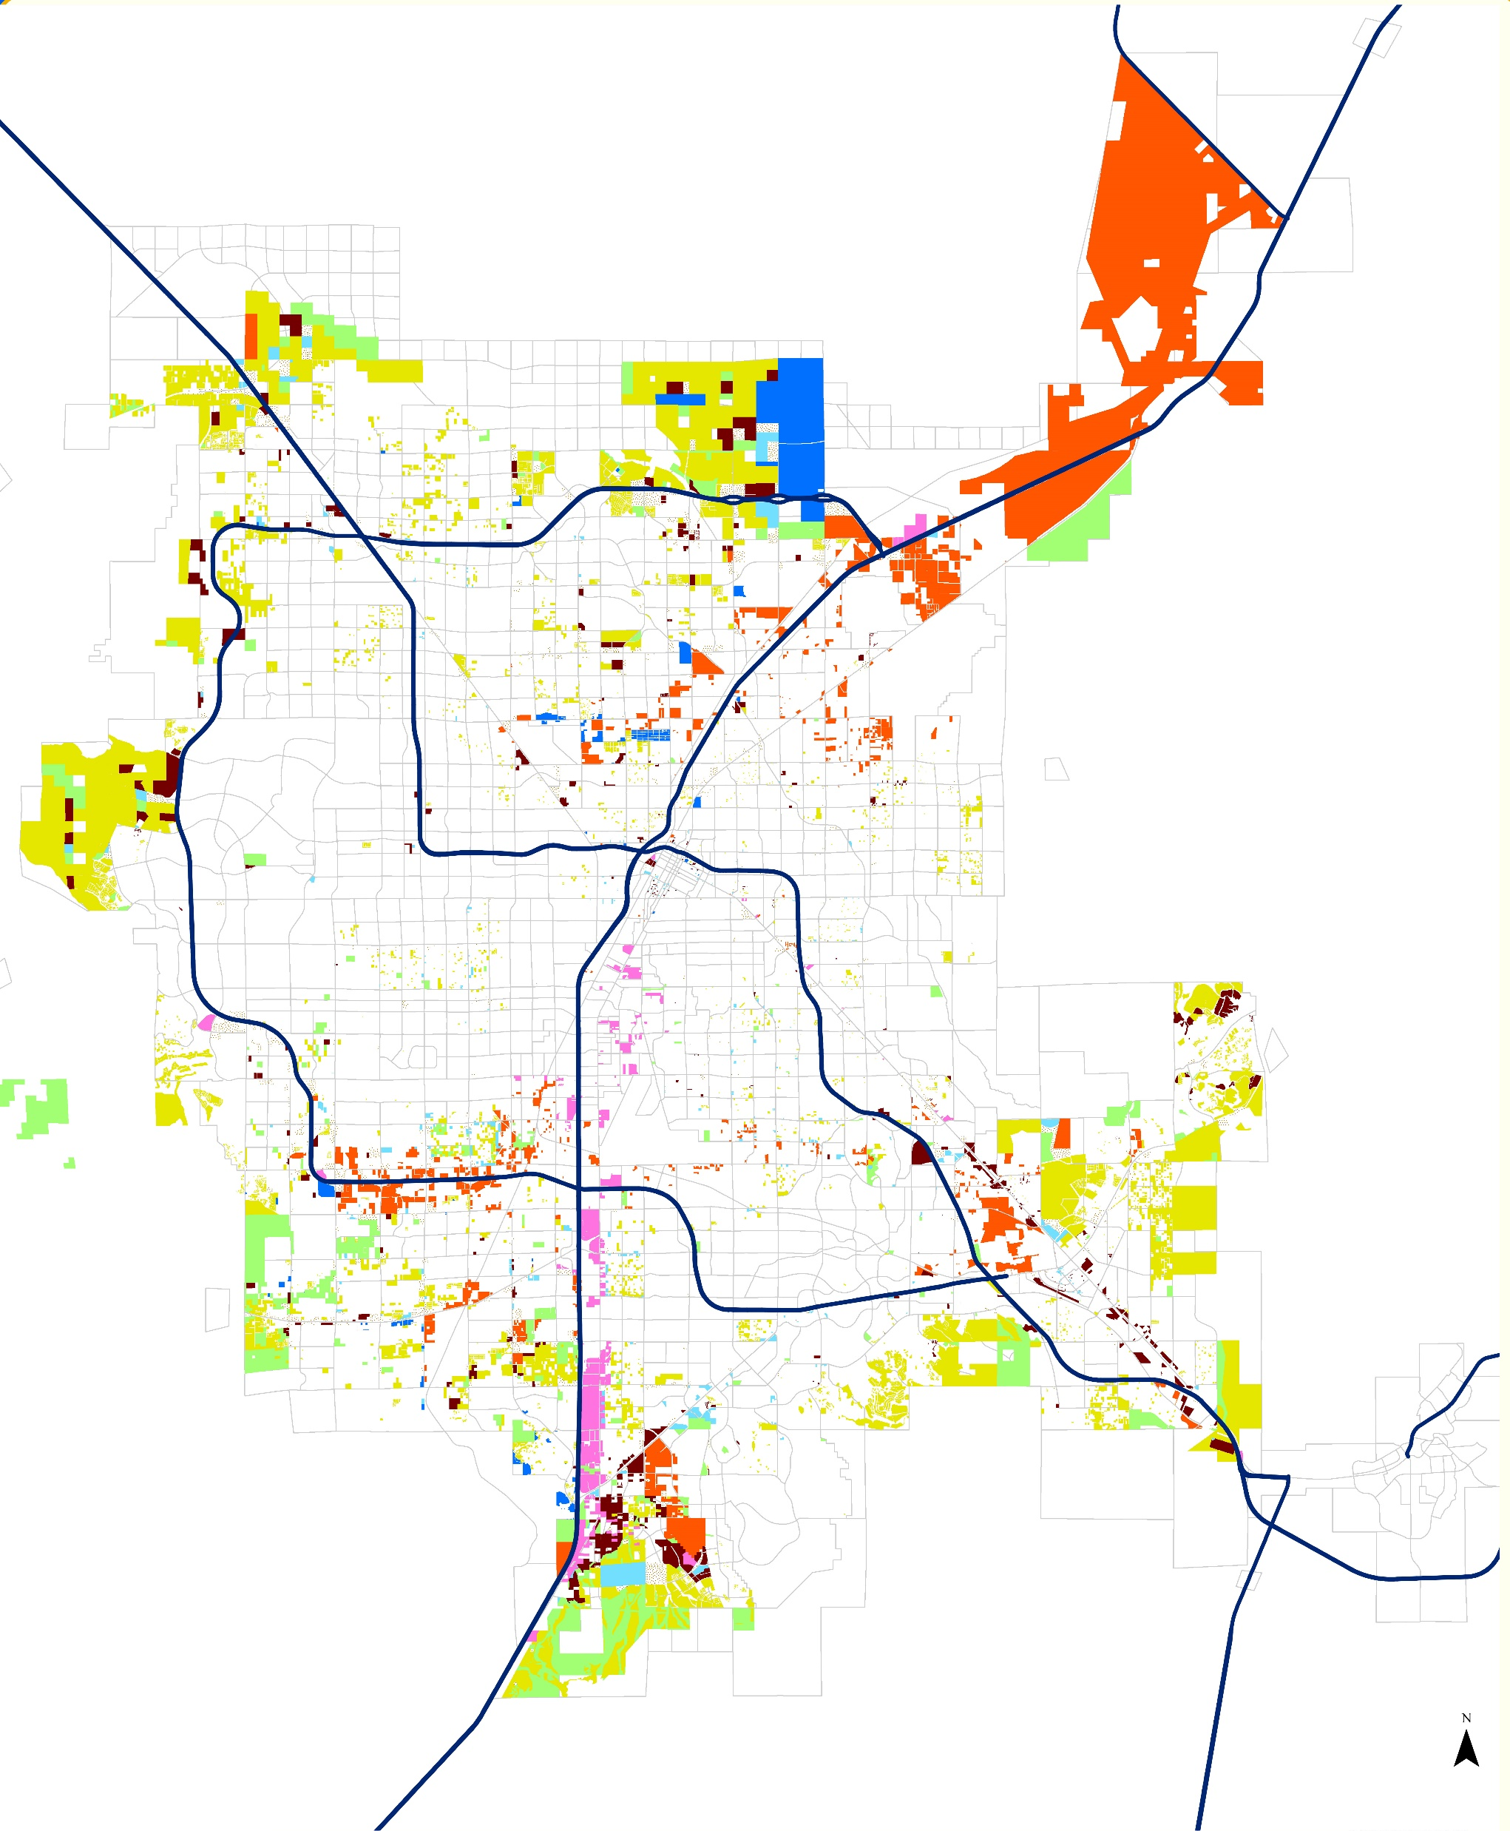
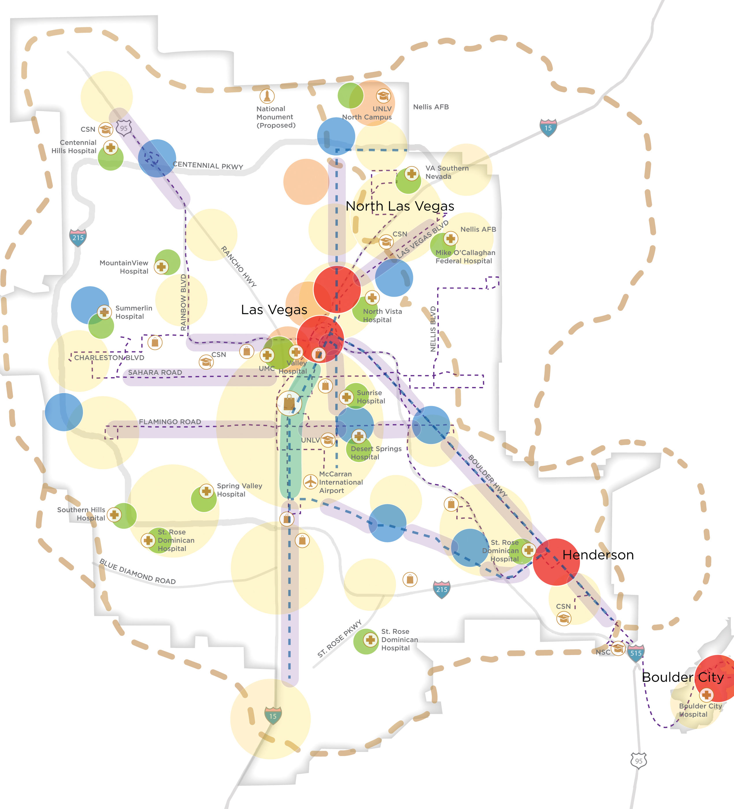
Southern Nevada Strong
2050 Projection
Growth Vision
Improve Economic Competitiveness & Education
Increase Transportation Choice
Invest in Complete Communities
Build Capacity for Implementation
Notes:
The Plan identifies the following goals:
First, improve our economic competitiveness and diversification, including improved education in support of workforce development
Second, increase transportation choices
Third, invest in complete communities with an emphasis on reinvesting in existing neighborhoods
And lastly, build capacity for implementation.
Over 300 actions are identified to implement regional plan goals – yes, 300!
Local agencies are identified to lead many of the tasks, things like development code updates.
The MPO directly serves in a dual role – we directly implement actions through transportation planning, such as the On Board Mobility Plan.
We also track implementation of actions - in areas such as water and education - that are under the purview of partner agencies and organizations.
However, we are also facing challenges with implementation. (Need to update TP’s in bold below)
On the left, we have the vision map from the previous slide.
On the right, we can see the projected growth through 2050. This map consolidates land use plans adopted by local agencies.
Much of the region’s growth and investment continues to occur at the urban edge.
There also appears to be a continued emphasis on single-family housing, shown in yellow.
Additionally, current land use and densities may contribute to a lack of housing supply overall, and specifically the availability of affordable housing.

Slide 11
Upcoming:
SOUTHERN NEVADA STRONG UPDATE
Engage
Infill Opportunities
Housing and Jobs Analysis
Scenario Planning
Action Plan
Notes:
Given current challenges and changes since the plan was developed nearly 10 years ago, the SNS Steering Committee asked us to update the regional plan.
We have connected with over 500 people through 1:1 interviews, a housing roundtable, industry focus groups, presentations, and listening sessions.
This outreach identified a few critical needs that we are addressing in the plan update.
First, the plan will include an inventory of vacant and underutilized land in established neighborhoods – such as empty parking lots and decaying commercial centers - to support redevelopment.
Next, we’ll use the inventory to imagine the location of quality homes, jobs, and public facilities we need as we grow.
Different ways of where growth occurs – existing neighborhoods, on the fringe, or some combination - will be tested through “scenario planning” a tool to look at trade-offs. Choices may result in higher or lower emissions, infrastructure costs, water use, affordable housing, and more.
Our hope is that this process results in a shared vision for growth, and a parcel-based, actionable regional plan.

Slide 12
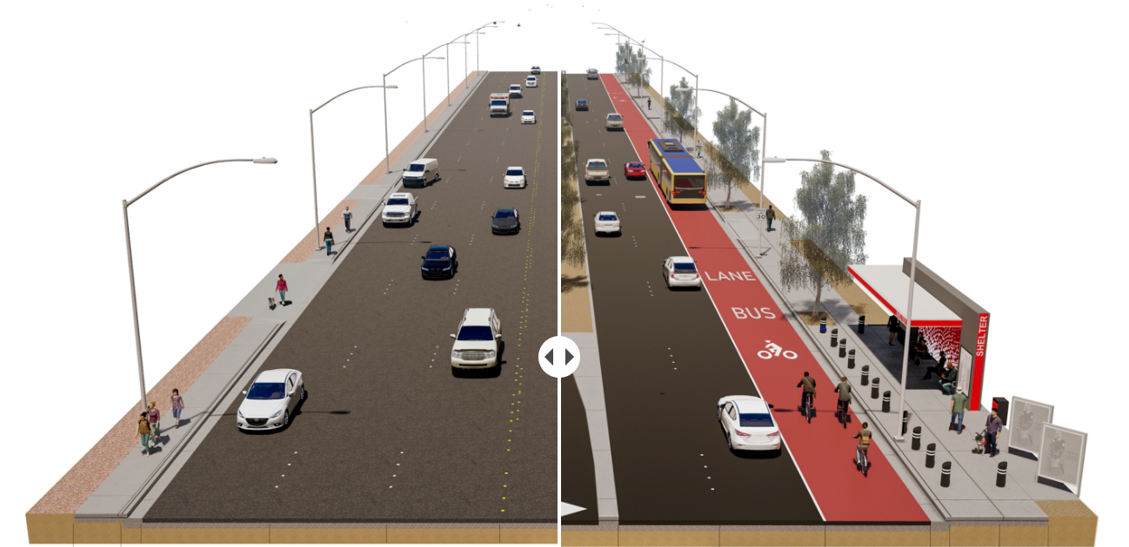
Maryland Parkway Updates
Upgraded lighting
Enhanced landscape and shade
Shared bus-bike lane
Enhanced transit shelters
Raised median
Wider sidewalks
Notes:
A project that we have been working on for several years is the Maryland Parkway Bus Rapid Transit project, which is one of our busiest transit routes in the system.
This is a vital corridor for the Las Vegas Valley, extending from the South Strip Transit Terminal in the south, to the Las Vegas Medical District in the north. This corridor is home to 90,000 residents and 80,000 jobs and carries approximately 9,000 transit riders and 35,000 vehicles daily. It also includes 25 transit route connections, nine of which are the busiest in the valley.
[CLICK FOR PROJECT HIGHLIGHTS]
As we plan to redesign the roadway and implement bus rapid transit, some project highlights include:
- Enhanced transit shelters designed to improve safety and comfort - Upgraded sidewalks widened from 5’ to 10’ - Shared bus-bike lanes - Landscape enhancements, including a new raised, landscaped median - Improvements to corridor lighting including new streetlights - Expanded transit service with reduced wait time
Most recently we put out a survey asking for input on design concepts for the new transit shelters and shared bus-bike lanes and received over 3,000 responses from the survey. We found that 65% of people who took the survey agree that the proposed enhancements will improve Maryland Parkway, 28% were neutral, and only 7% did not feel this was an improvement to the corridor.
BACKGROUND
The RTC awarded a design contract to GCW Engineering in October 2020 and a pre‐construction services contract was awarded to Kiewit Infrastructure West in June 2021.
(Updated by MS on 7.14.22)

Slide 13
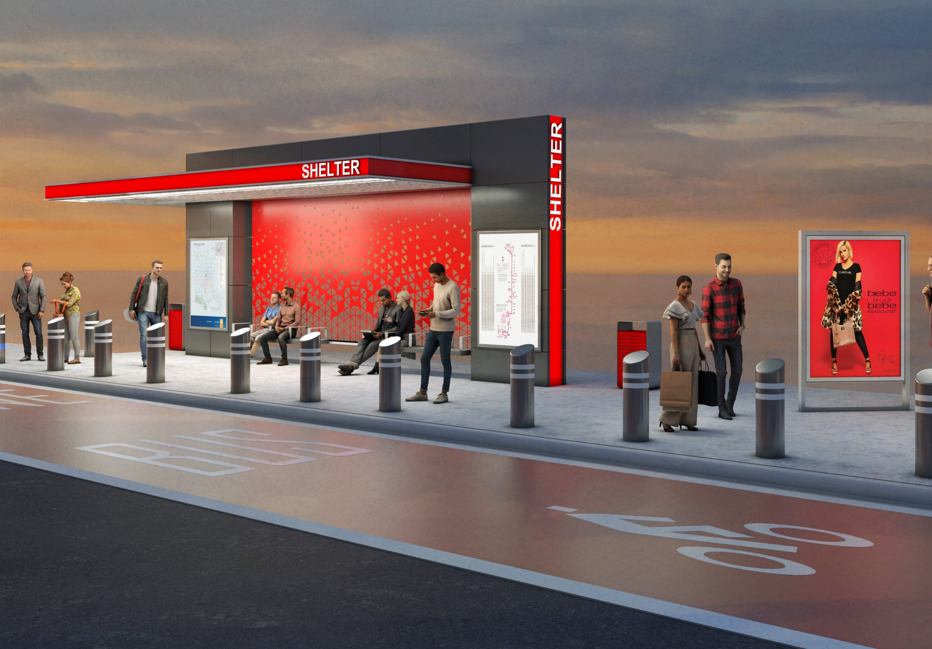
Maryland Parkway BRT
Upgraded lighting
Enhanced landscape and shade
Shared bus-bike lane
Enhanced transit shelters
Raised median
Wider sidewalks
Notes:
A project that we have been working on for several years and is part of both On Board and Access 2050, is the Maryland Parkway Bus Rapid Transit project, which is one of our busiest transit routes in the system.
This is a vital corridor for the Las Vegas Valley, extending from the South Strip Transit Terminal at its southernmost point, to the Las Vegas Medical District at its northernmost stop. This corridor is home to 90,000 residents and 80,000 jobs and carries approximately 9,000 transit riders and 35,000 vehicles daily. It also includes 25 transit route connections, nine of which are among the busiest in the valley.
As we plan to redesign the roadway and implement bus rapid transit, some project highlights include:
- Enhanced transit shelters designed to improve safety and comfort - Upgraded sidewalks widened from 5’ to 10’ - Shared bus-bike lanes - Landscape enhancements, including a new raised, landscaped median - Improvements to corridor lighting, including new streetlights - Expanded transit service with reduced wait times

Slide 14
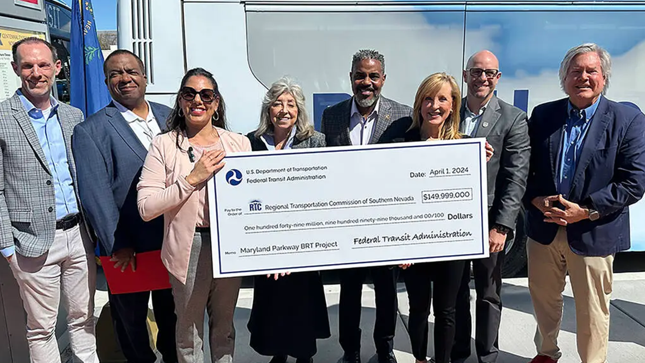
Maryland Parkway BRT
Upgraded lighting
Enhanced landscape and shade
Shared bus-bike lane
Enhanced transit shelters
Raised median
Wider sidewalks
Notes:
In April of this year, the RTC received nearly $150 million in grant funding from the Federal Transit Administration for the Maryland Parkway Bus Rapid Transit project. This key transportation project will add updated transit shelters, shared bus-bike lanes, widened sidewalks, and 15 new hydrogen fuel cell electric vehicles to a very busy corridor.
We are kicking off community and stakeholder engagement this month (May).
Construction is scheduled to break ground in August or September this year.
BACKGROUND
The Maryland Parkway BRT project will span 13 miles from the South Strip Transit Terminal to the Las Vegas Medical District – a corridor that is home to 90,000 residents, 85,000 jobs and 9,000 daily transit rides.
PHOTO FROM LEFT:
Clark County Commissioner & RTC Chairman Justin Jones, UNLV President Dr. Keith Whitfield, Federal Transit Administration Acting Administrator Veronica Vanterpool, Rep. Dina Titus (D-NV), Rep Steven Horsford (D-NV), RTC CEO M.J. Maynard, Las Vegas Councilman & RTC Board Member Brian Knudsen and Clark County Chairman & RTC Board Member Tick Segerblom.

Slide 15
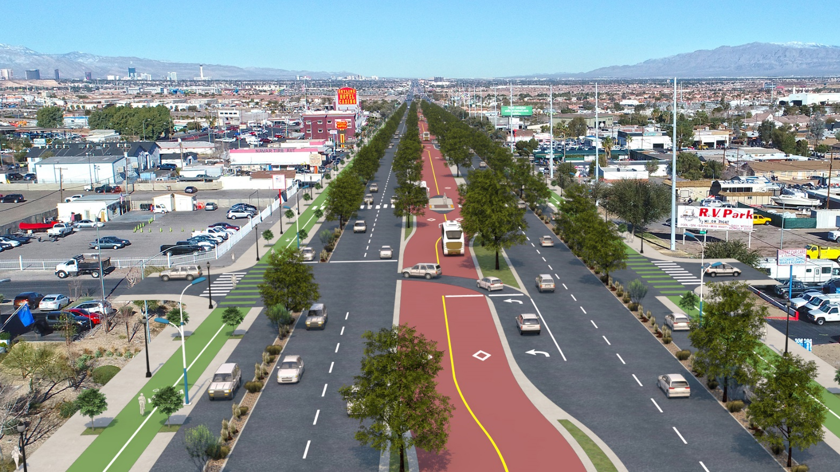
Completing
Reimagine Boulder Highway
Build America Bureau | Regional Infrastructure Accelerator (RIA) Program
Notes:
Completing Reimagine Boulder Highway

Slide 16
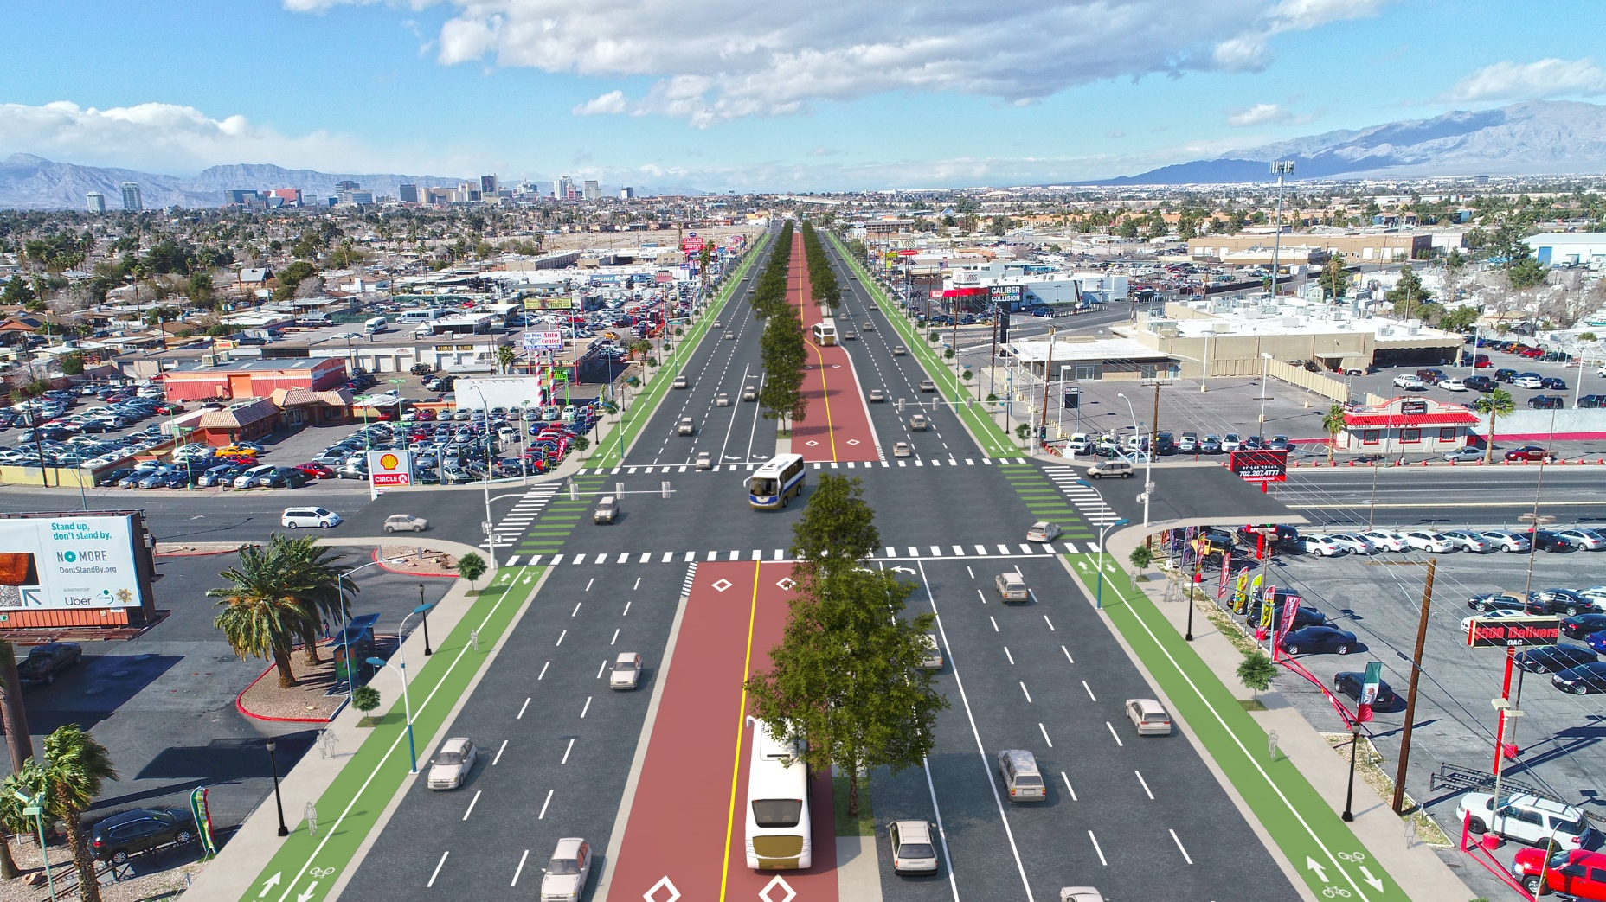
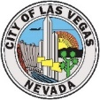
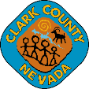
Regional Infrastructure Accelerator (RIA)
City of Las Vegas
Partner coordination (Las Vegas, Clark County, NDOT)
NEPA Environmental Review
Preliminary Engineering
Funding & Financing Options Analysis
Charleston Blvd
Clark County
Nellis Blvd
Flamingo Rd
Eastern Ave
Project Area
TULIP FALLS DR TO CHARLESTON BLVD
BOULDER HWY
Warm Springs Rd
Lake Mead Pkwy
Bermuda Rd
City of Henderson
Notes:
Through this project, we’ll be working with NDOT, CC, CLV to accelerate projects in the northern half of the corridor (north of Tulip Falls).
Thru 1 project can address 10% of pedestrian fatalities in the state!
Identify complexities

Slide 17
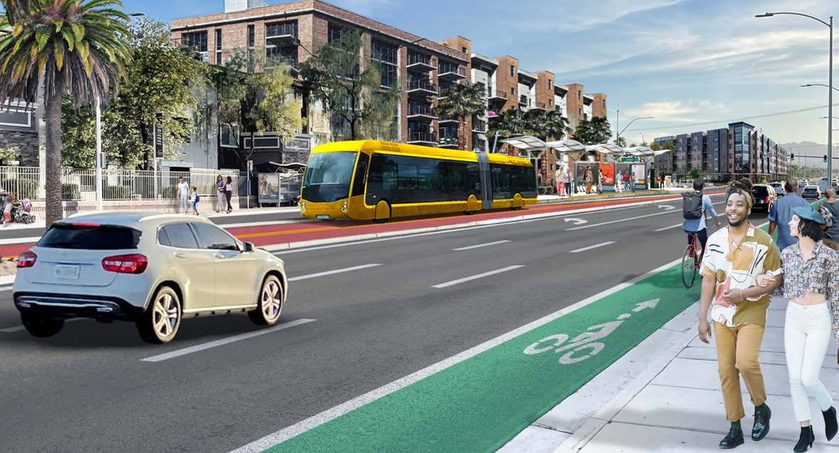
Charleston Blvd. Alternatives Analysis
USDOT | Rebuilding American Infrastructure with Sustainability and Equity (RAISE) Program
Notes:
Charleston RAISE

Slide 18
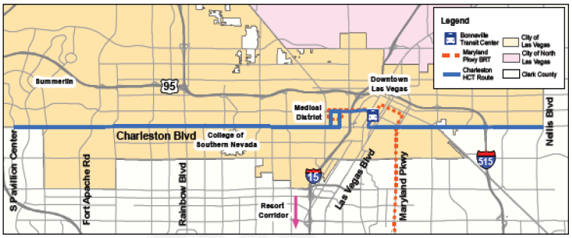
RAISE Project | Charleston Blvd. Transit Corridor Alternatives Analysis
Notes:
Project area: 17 miles long between Pavilion Center (to the west) and Nellis Blvd (to the east).
Rte. 206 runs along Charleston – has the region’s third highest ridership.

Slide 19
Evaluate transit alternatives along Charleston Blvd. to identify a Locally Preferred Alternative and Minimum Operable Segment that best meets the purpose and need of the project
RAISE Project | Charleston Blvd. Transit Corridor Alternatives Analysis
Notes:
Analyzing transportation options to determine what type of transit technology/transportation solution is best suited for the corridor and its transportation and community development needs.
Will look at a variety of transportation alternatives (from street car and light rail to BRT and emerging technologies).
Will result in a locally-preferred alternative.
The Alternatives Analysis is an important step toward applying for federal funding to implement/build the LPA.

Slide 20
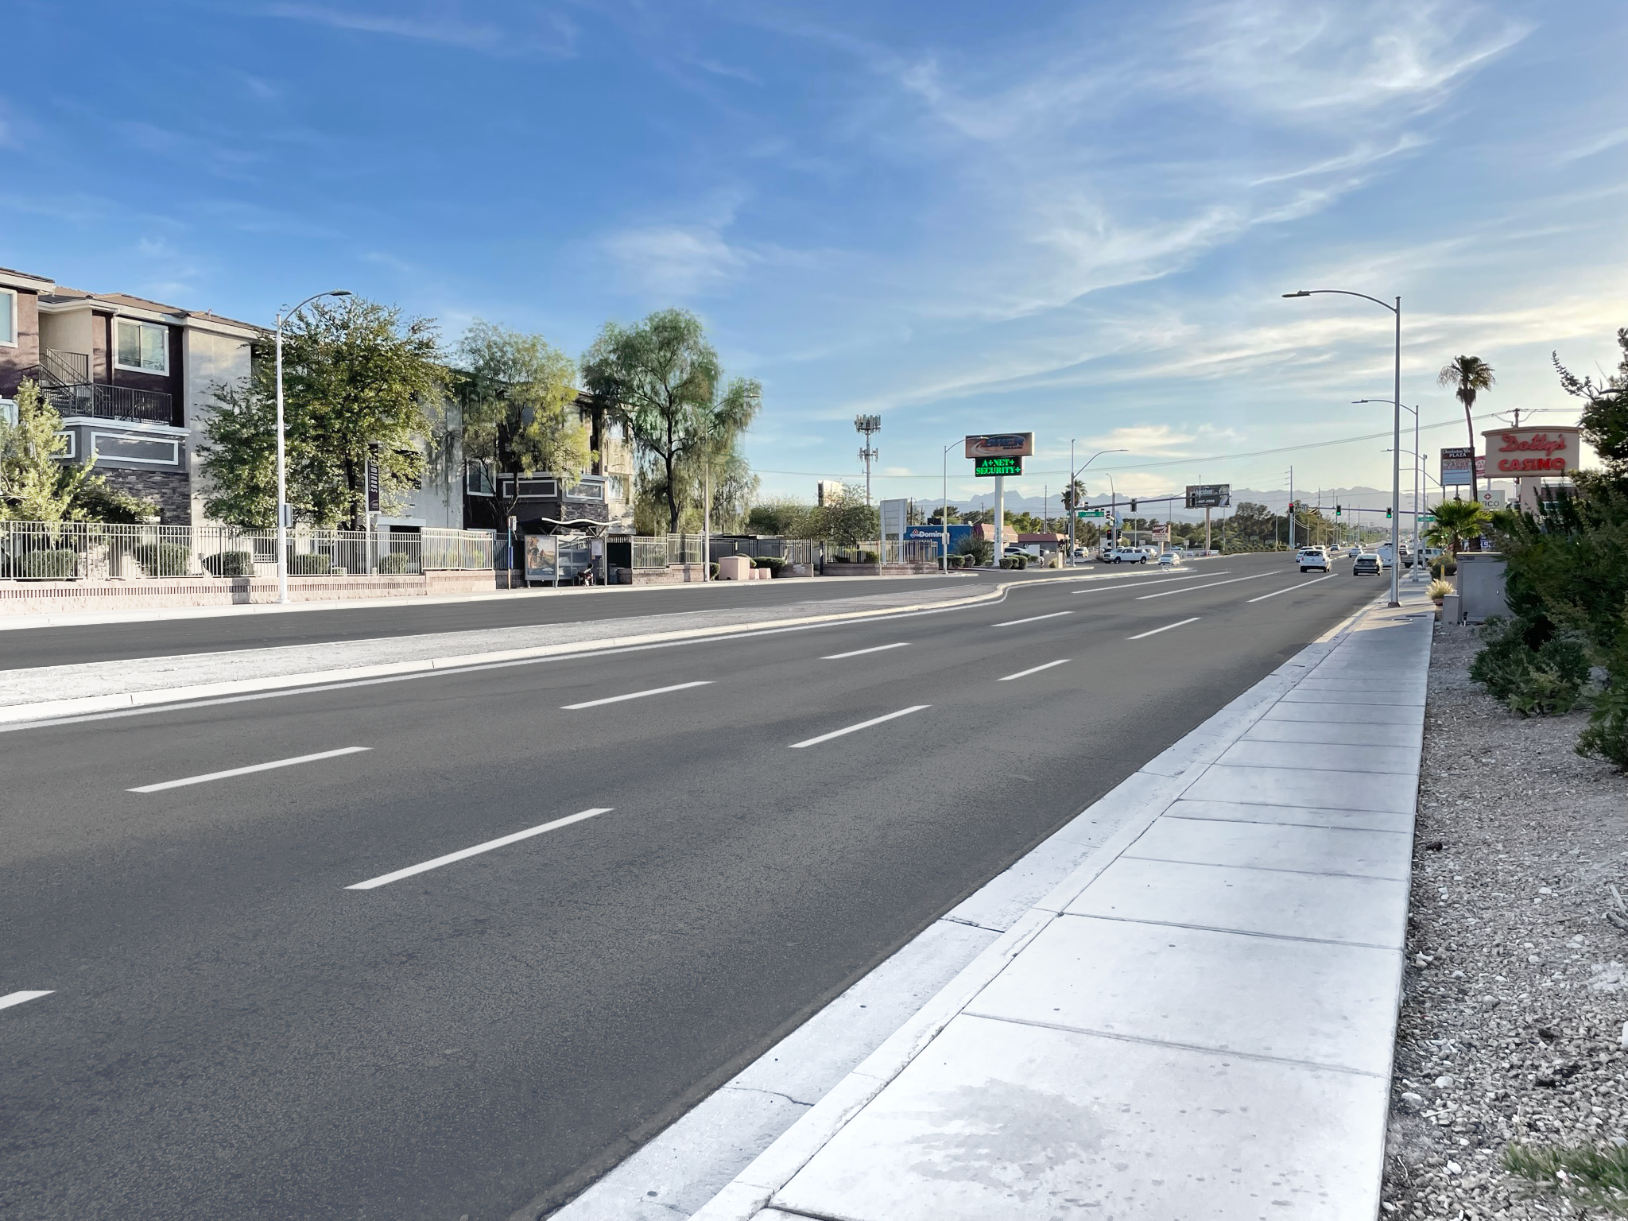
Notes:
Charleston RAISE

Slide 21
Notes:
Charleston RAISE

Slide 22
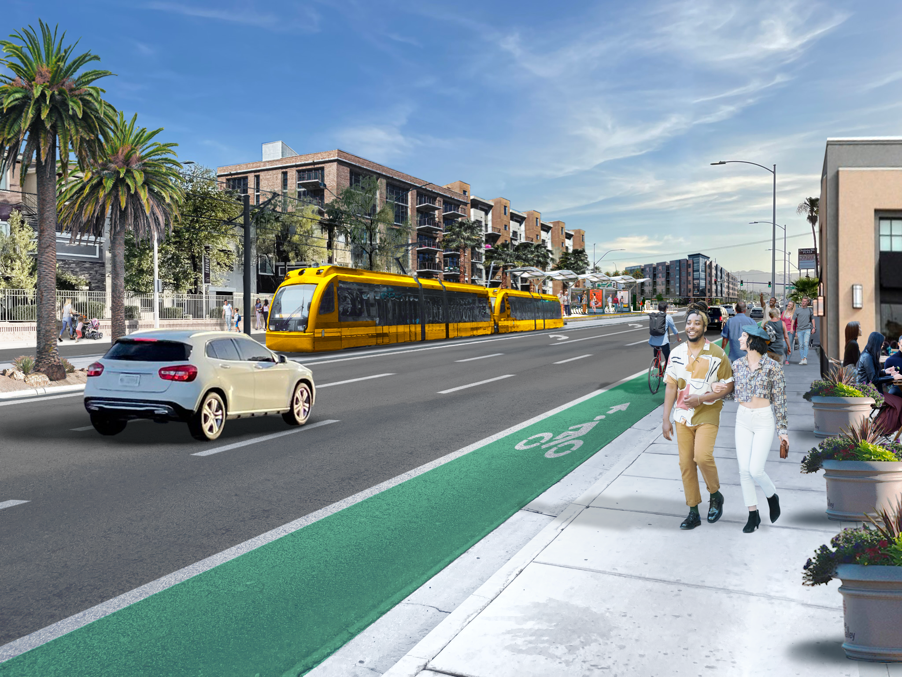
Notes:
Charleston RAISE

Slide 23
Project Highlights
Larger Funding Picture
Community Engagement
Economic Development
Corridor Planning
Coordination with FTA
RAISE Project | Charleston Blvd. Transit Corridor Alternatives Analysis

Slide 24
Seeing Orange
Notes:
The RTC originally launched the Seeing Orange website in 2015 as a one-stop location for our community to access information on construction zones and longer-term project information. We gave the website a facelift and new tools earlier this year, and it now includes links to real-time traffic alerts, transit rider alerts and detours, and special event information and impacts.
We are promoting the updated website through digital advertising, print advertising, and out-of-home advertising, as you see on the slide.

Slide 25
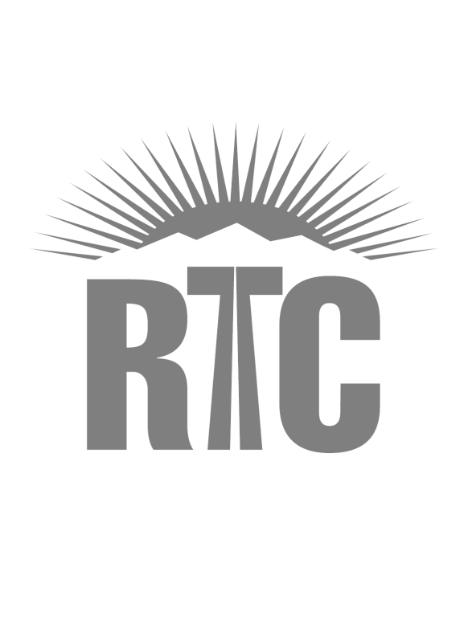
Notes:
Thank you for your time and I am available to answer any questions.

